Slide 1
Nostalgia

Slide 2
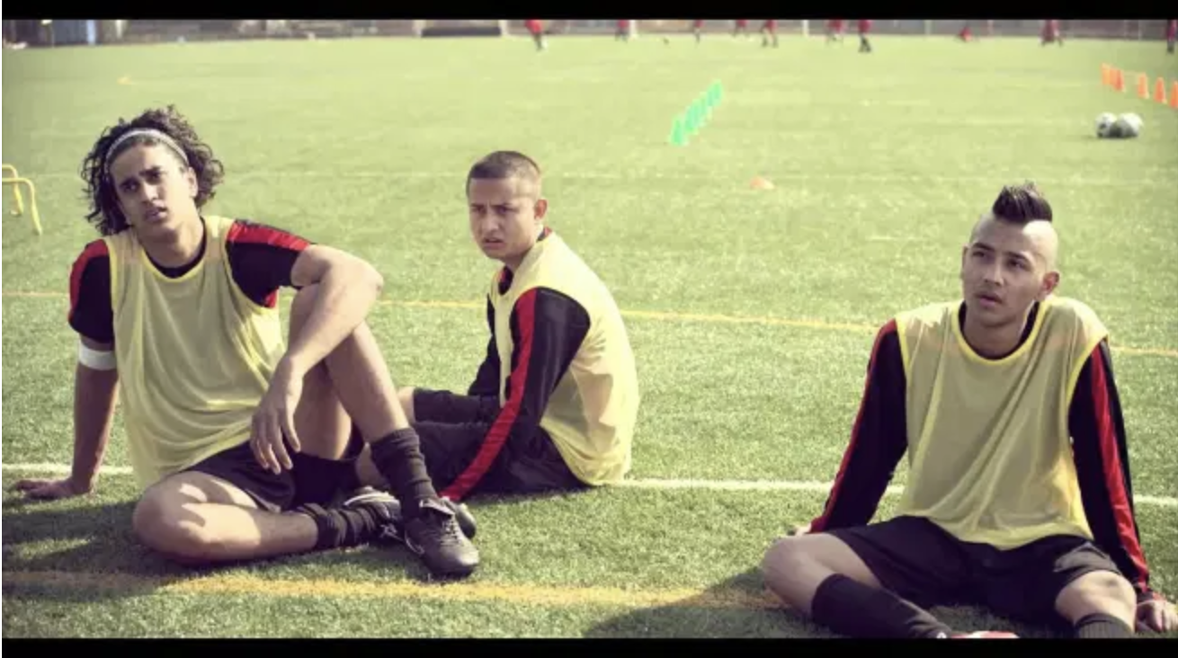
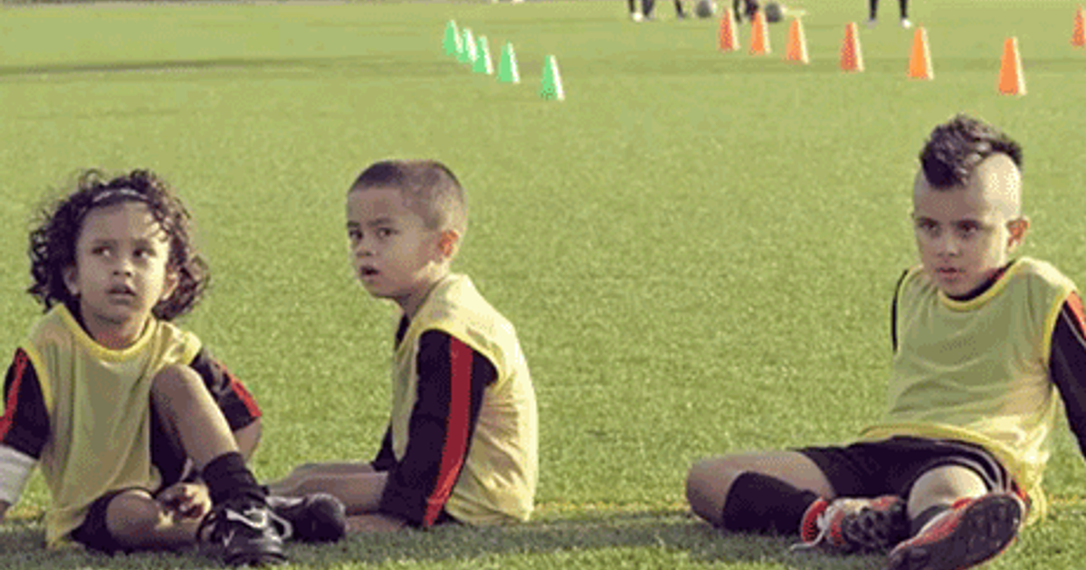
We saw these three teenagers transform into three drooling toddlers for which drink?
Notes:
frooti

Slide 3
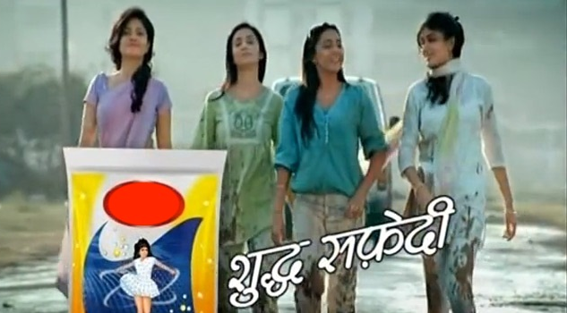
Identify this ad and sing the full jingle to get points
Notes:
nirma

Slide 4
IDENTIFY THE BRAND USING THE FAMOUS AD JINGLE “Oye Bubbly, oye oye Bubbly, be my lover Bubbly”
Notes:
pepsi

Slide 5
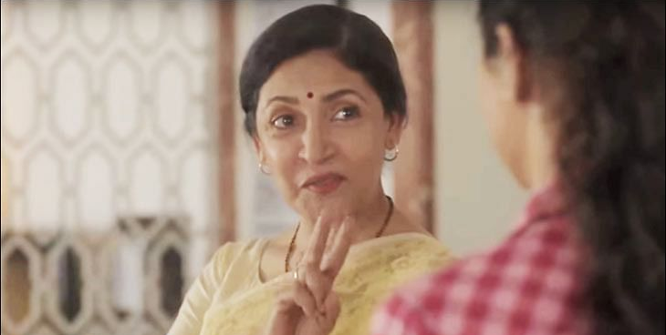
Deepti Naval kills hunger in this ad for which product
Notes:
maggi

Slide 6
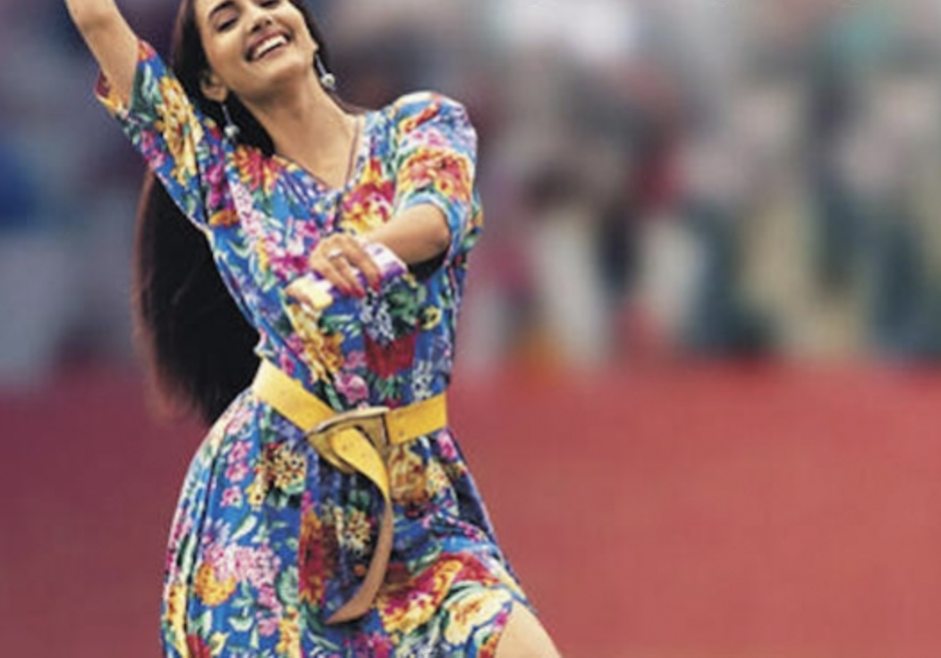
The commercial for which chocolate saw model Sophiya Haque shake a leg on the cricket field?
Notes:
Cadbury dairy milk

Slide 7
IDENTIFY THE BRAND USING THE FAMOUS AD JINGLE
“Har ek friend zaroori hota hai”
Notes:
airtel

Slide 8
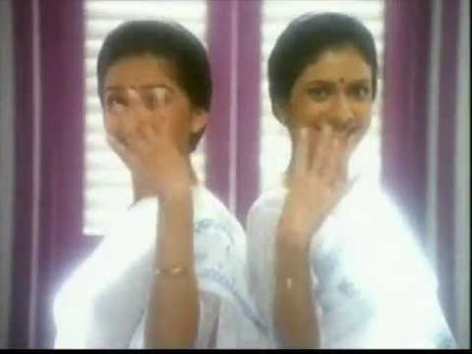
Identify the AD and sing the jingle to get points
Notes:
ujala

Slide 9
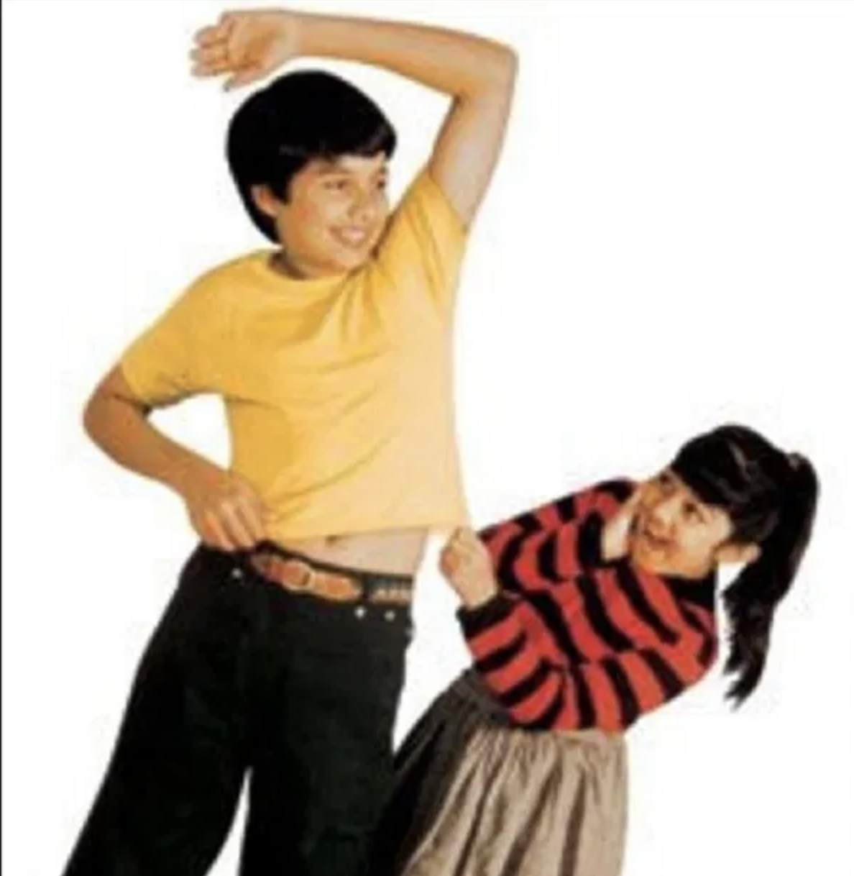
What were these mini versions of Ayesha Takia & Shahid Kapoor harping on about?
Notes:
complan

Slide 10
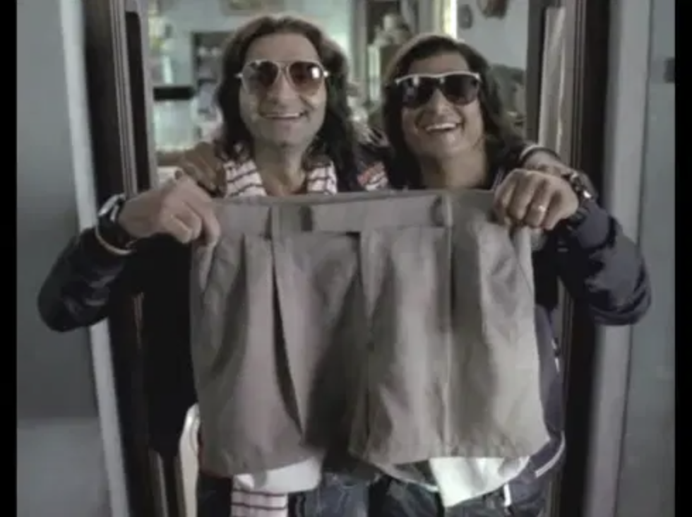
Popular fictional characters ‘Ramesh’ & ‘Suresh’ lose all focus after eating what?
Notes:
Five star

Slide 11
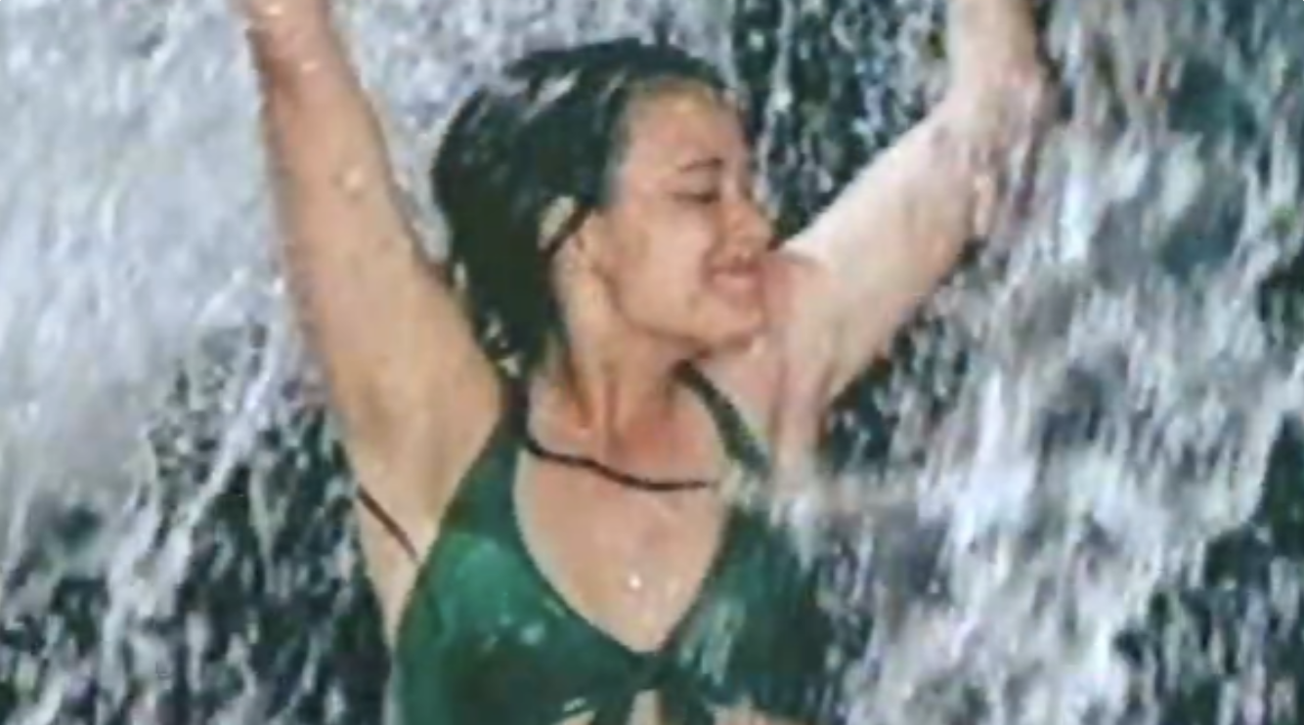
Identify this iconic soap commercial
Notes:
Liril

